Slide 1
English for
International
Communication

Slide 2
奠基篇 Unit 6
Part 5 句子填空
&
Part 6 短文填空

Slide 3
奠基篇 Unit 6
題型說明
多益測驗Part 5「句子填空」及Part 6「短文填空」是我們俗稱的「文法題」，旨在測驗考生的語感、基本字彙、以及對基礎文法的熟悉度。Part 5 句子填空共有30 題，題題獨立，互不相關。Part 6 則是由四篇文章組成，每篇有4 題填空題，整個大題共16 題。此大題加入句子選擇題型，測驗考生是否理解文章上下文意及脈絡。

Slide 4
奠基篇 Unit 6
題型分析
題型1 | 考詞性
題型2 | 考動詞時態
題型3 | 考片語／慣用語
題型4 | 考意思
題型5 | 依上下文插入完整句

Slide 5
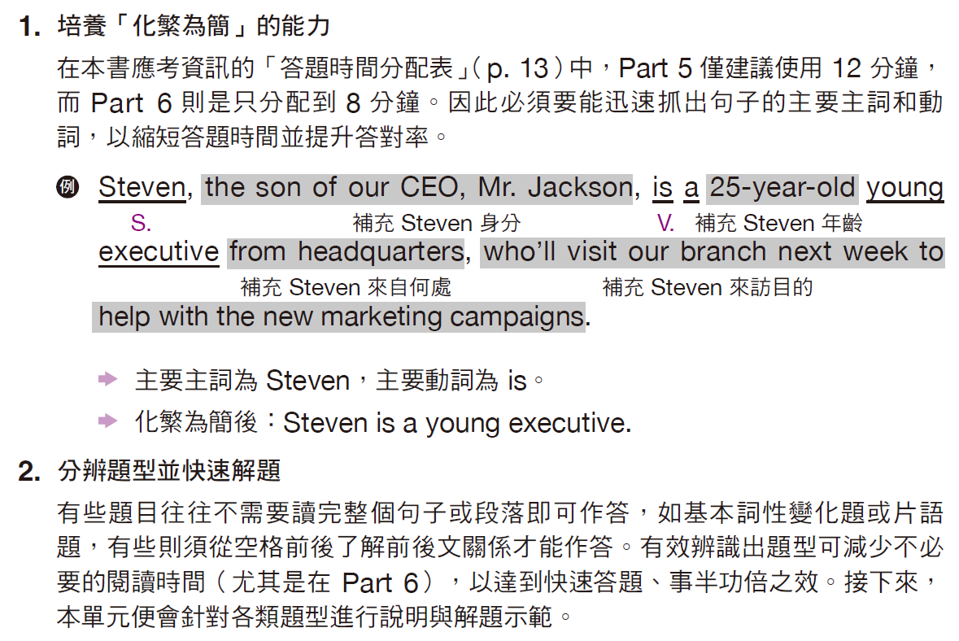
奠基篇 Unit 6
應考技巧

Slide 6
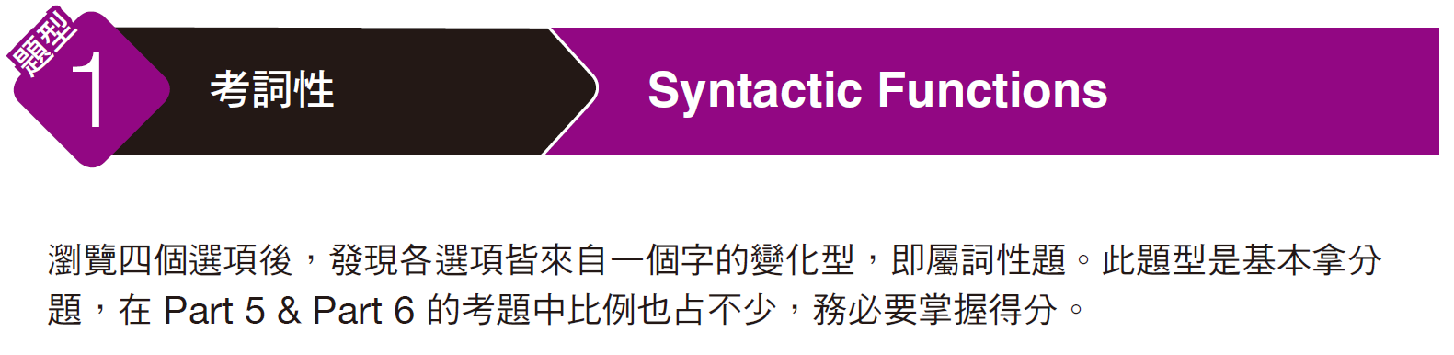
奠基篇 Unit 6
Example
A
______ There are less guests showing up at the wedding banquet than the Lees ------- predicted.
(A) originally
(B) original
(C) origin
(D) originated
解析
本句答案須修飾動詞 predicted，故選答案為副詞的 (A) originally「原先地」。

Slide 7
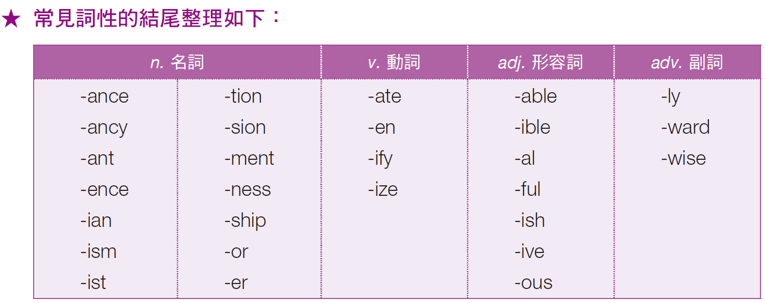
奠基篇 Unit 6

Slide 8
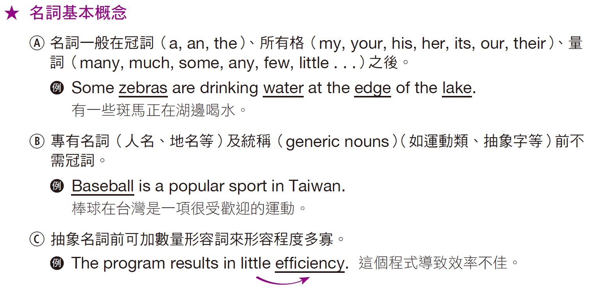
奠基篇 Unit 6

Slide 9
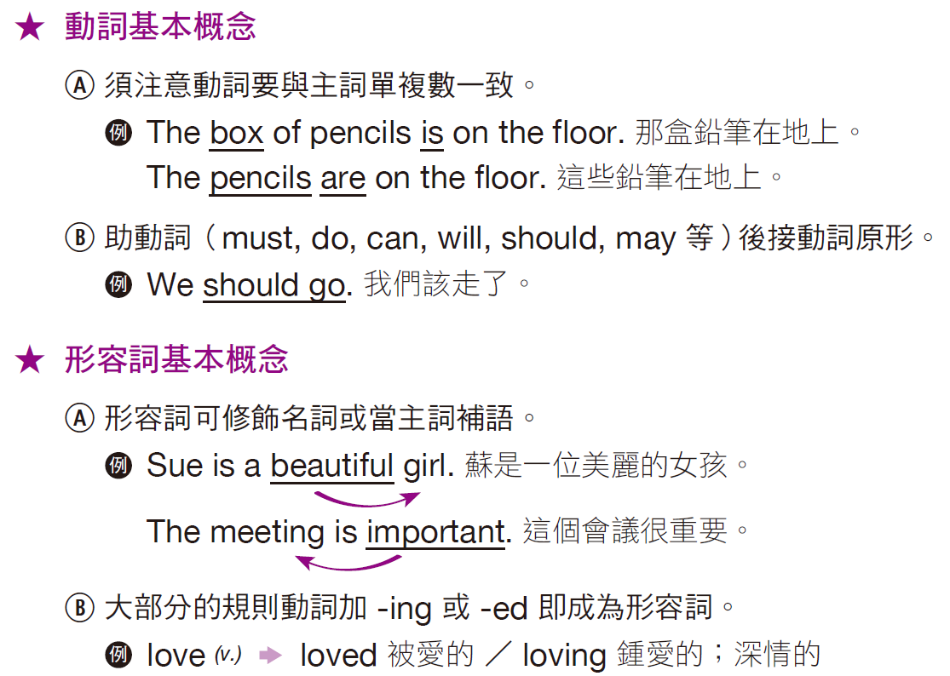
奠基篇 Unit 6

Slide 10

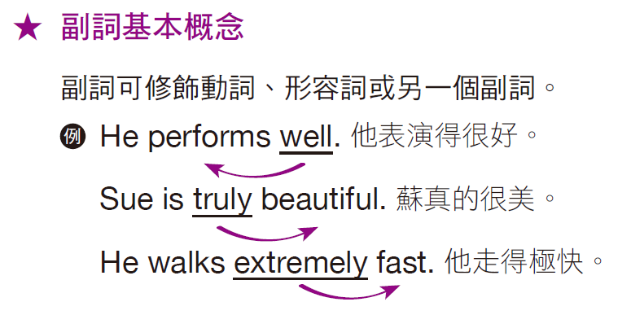
奠基篇 Unit 6

Slide 11
奠基篇 Unit 6
Exercise
A word or phrase is missing in each of the sentences below. Select the best answer to complete the sentence.
B
______ 1. When Tina is nervous, she ------- sitting on a beach and relaxing.
(A) image
(B) imagines
(C) imaging
(D) imagination
當蒂娜緊張的時候，她想像坐在沙灘上放鬆。

Slide 12
奠基篇 Unit 6
C
D
______ 2. We studied the ------- we received to better understand the problem.
(A) analyze
(B) analyzing
(C) analysis
(D) analysts
我們仔細研究收到的分析，以便更加瞭解問題所在。
______ 3. Is your boss going to give you any ------- vacation time this year?
(A) addition
(B) additionally
(C) add
(D) additional
你老闆今年會給你任何額外的假期嗎？

Slide 13
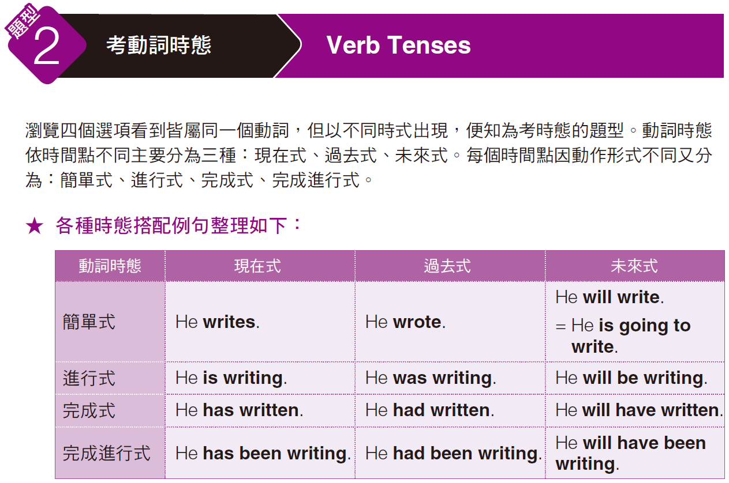
奠基篇 Unit 6

Slide 14
奠基篇 Unit 6
Examples
C
______ 1. Cell phones ------- very popular right now because they bring convenience into our lives.
(A) became
(B) becoming
(C) are becoming
(D) to become
______ 2. I think that your past presentation has ------- on the Intranet.
(A) been posting
(B) her post
(C) posted
(D) been posted
解析
看到時間副詞 right now「現在」，表示句子時態為現在，僅有選項 (C) 符合。
D
解析
由選項可判斷出句意為「我認為你的簡報已經被放在內部網路上了。」，
簡報（presentation）為事物，應用被動語態，故此題正解為選項 (D)。

Slide 15
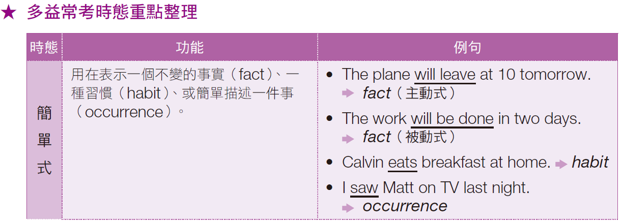
奠基篇 Unit 6

Slide 16
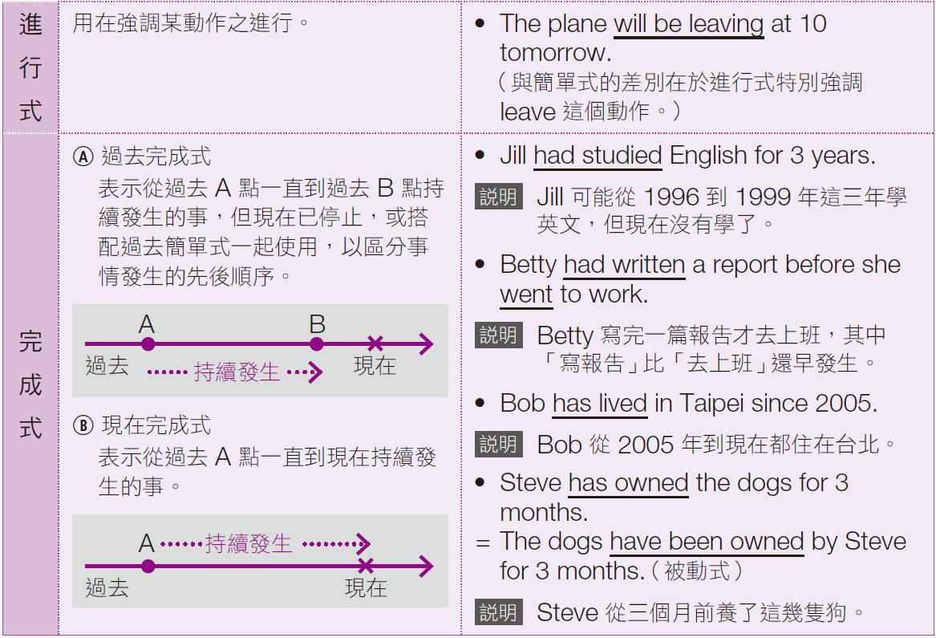
奠基篇 Unit 6

Slide 17
奠基篇 Unit 6
Exercise
A word or phrase is missing in each of the sentences below. Select the best answer to complete the sentence.
D
______ 1. I hope Janet is OK; I haven’t ------- to her in months.
(A) speak
(B) spoke
(C) speaking
(D) spoken
我希望珍娜一切都好，我已經好幾個月沒跟她說到話了。

Slide 18
奠基篇 Unit 6
______ 2. Your presentation is excellent, but you might want to
------- it by a couple minutes.
(A) be shortened
(B) shorten
(C) be shorten
(D) have shortened
你的簡報很棒，但你或許可以將它所短幾分鐘。
______ 3. The packages ------- up in several days because of the drivers’ strike.
(A) aren’t picking
(B) won’t pick
(C) haven’t picked
(D) haven’t been picked
因為司機罷工，因此許多包裹已經數天沒有被載運了。
B
D

Slide 19
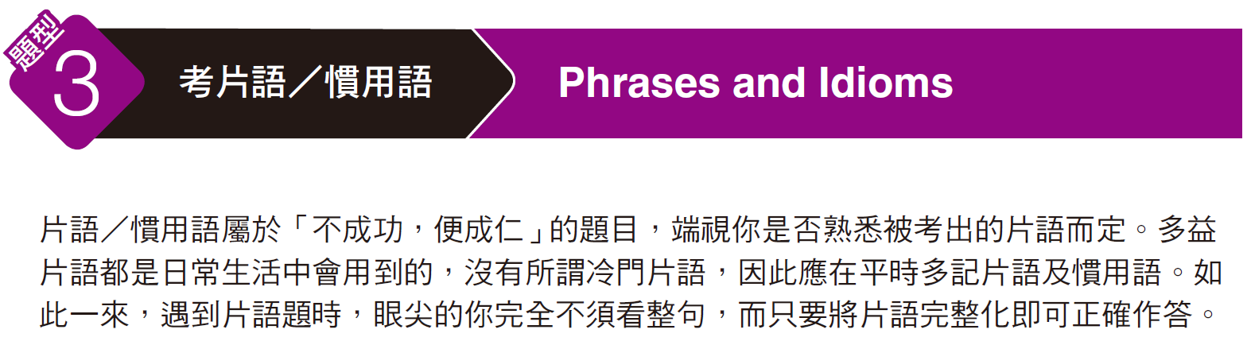
奠基篇 Unit 6

Slide 20
奠基篇 Unit 6
Example
______ In order ------- catch up with the delayed production of its air conditioners, the manufacturer asked its employees to work overtime for the weekend.
(A) of
(B) for
(C) to
(D) that
若你認識片語 in order to + V.（為了～），則可以在一秒鐘的時間內有自信地
選出答案 (C)，完全不須理會句子的意思。相反地，不知道該片語的人則可能
要花一分鐘的時間念完整句，且不一定能選出正確答案！
C
解析

Slide 21
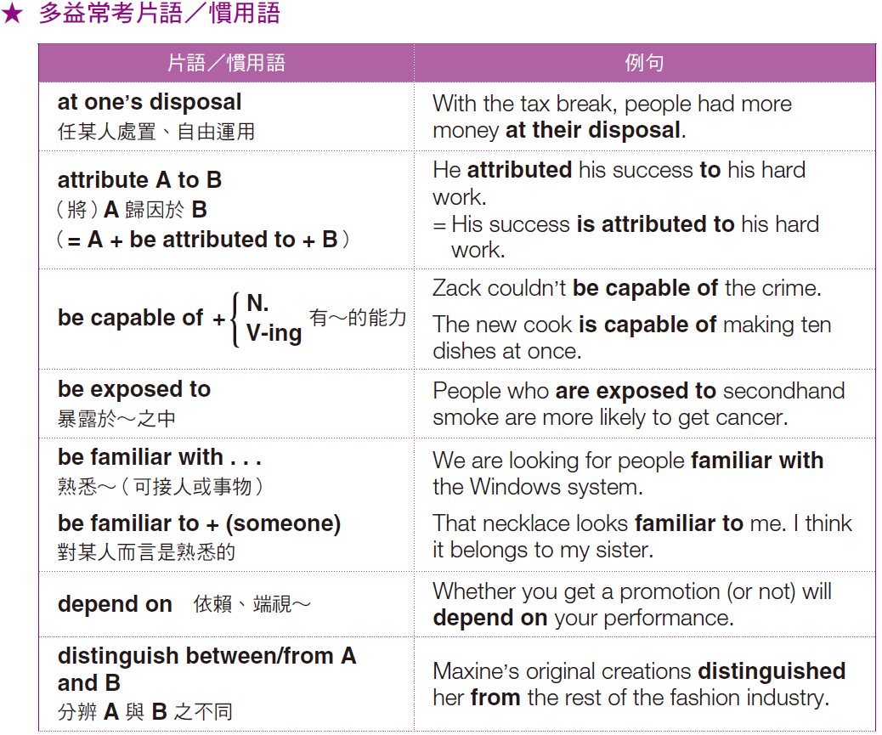
奠基篇 Unit 6

Slide 22
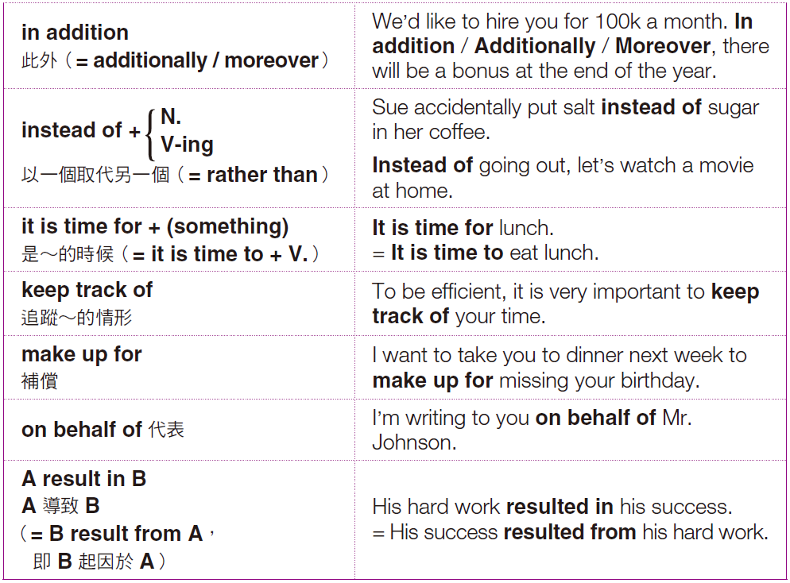
奠基篇 Unit 6

Slide 23
奠基篇 Unit 6
Exercise
A word or phrase is missing in each of the sentences below. Select the best answer to complete the sentence.
D
______ 1. My roommate said she would ------- me off at my office on her way to work.
(A) get
(B) move
(C) take
(D) drop
我室友說在她上班途中可以順道讓我在辦公室下車。

Slide 24
奠基篇 Unit 6
B
______ 2. Please ------- up the volume on the radio so that everyone can hear it.
(A) take
(B) turn
(C) tune
(D) tell
請把收音機的音量調大好讓每個人都聽得到。
______ 3. Having forgotten my appointment with Gina, I offered to buy her lunch to make ------- it.
(A) up
(B) up to
(C) up at
(D) up for
因為先前忘記我和吉娜有約，我提議請她吃午餐來當作補償。
D

Slide 25
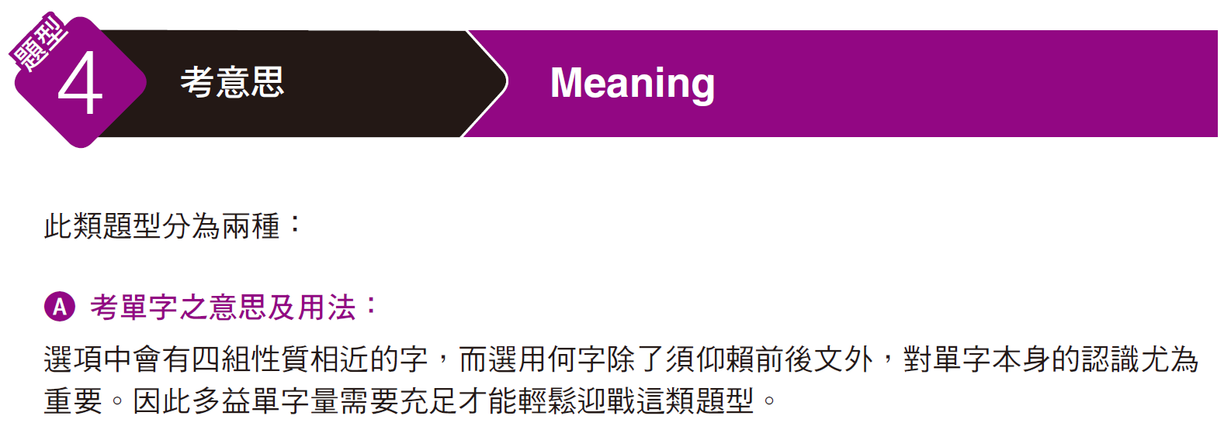
奠基篇 Unit 6

Slide 26
奠基篇 Unit 6
Examples
A
______ 1. The company ------- its inventory in a large warehouse down the street.
(A) stores
(B) guarantees
(C) confirms
(D) argues
本題句子的大意為：公司……它的存貨在一個大倉庫。在尚未看選項前，你應該已知道空格中缺主要動詞。至於用何者才適切，完全考你是否認得這些單字。選項中只有 (A) stores「存放；貯存」合理，也才是正確答案。
解析

Slide 27
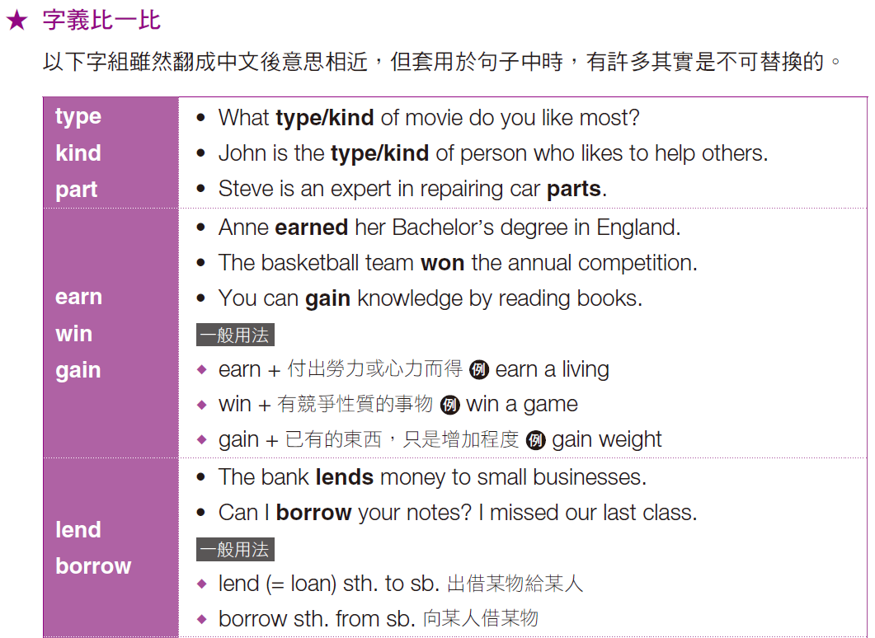
奠基篇 Unit 6

Slide 28

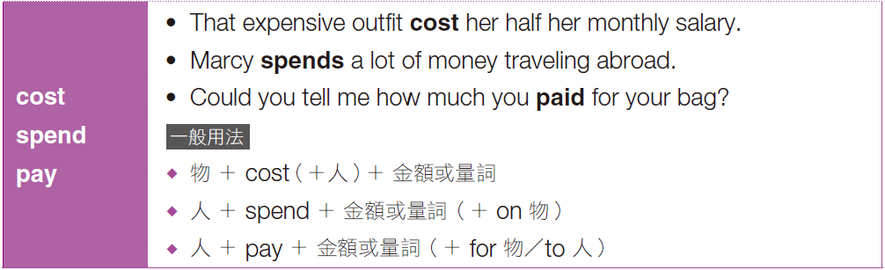
奠基篇 Unit 6

Slide 29
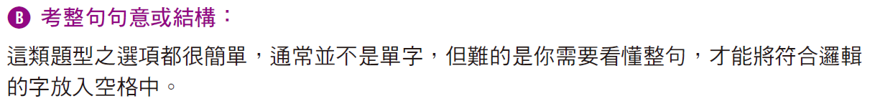
奠基篇 Unit 6
Examples
______ 1. Mary won’t be able to go to the movies with her family this weekend, ------- she has to go to Boston on a business trip.
(A) or
(B) so
(C) and
(D) since
本題句子的大意為：瑪莉無法去看電影，……她要到Boston出差。連接前後句合理單字為「因為」，故答案為 (D) since。
D
解析

Slide 30
奠基篇 Unit 6
Exercise
A word or phrase is missing in each of the sentences below. Select the best answer to complete the sentence.
B
______ 1. Gina ------- her car to me so I could go to the store.
(A) borrowed
(B) lent
(C) loan
(D) borrow
吉娜借車給我因此我才能前往商店。

Slide 31
奠基篇 Unit 6
C
______ 2. Many companies have had to ------- jobs because of the bad economy.
(A) slice
(B) dice
(C) cut
(D) throw
因為經濟不佳，許多公司都已經必須刪減職缺。
______ 3. Tonight’s annual town hall meeting will go ahead as planned ------- the bad weather predicted for this evening.
(A) despite
(B) because
(C) in case of
(D) in spite
今晚的年度市政會議會依照原定計畫進行，儘管氣象預報說今晚會是壞天氣。
A

Slide 32
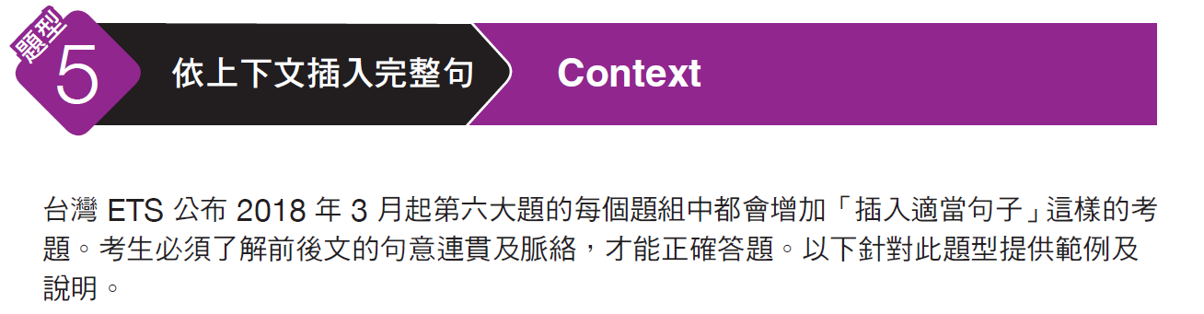
奠基篇 Unit 6

Slide 33
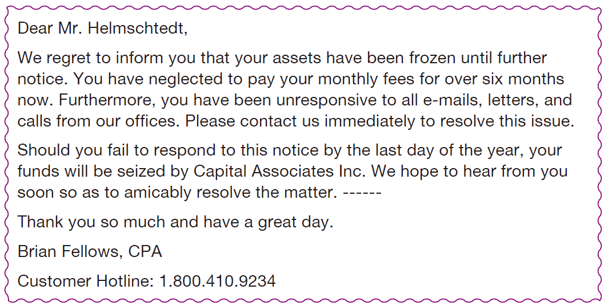
奠基篇 Unit 6
Examples
B
______ Q: (A) Tomorrow we will call you three times.
(B) You can contact us directly by simply calling the hotline below.
(C) Thank you for taking care of this so quickly.
(D) We are glad things worked out for the best.

Slide 34
奠基篇 Unit 6
解析
由本文一開頭得知此信目的乃通知客戶其資產被凍結（your assets have been frozen），而空格的前兩句又進一步提醒若客戶未能於期限內回應此通知信函，其資產將被沒收（your funds will be seized），然後表達希望能盡快聽到客戶的回應並妥善解決問題。延續此句意，可推測寫信者接著會告知客戶如何與該公司聯繫，以達到解決問題之目的。故答案選(B)「只要撥打下面的熱線，您便能直接與我們聯絡」。其他選項：(A)「明天我們將打三次電話給您」，因前面已說明希望客戶主動與該公司聯絡，故不適當；(C)「感謝您能如此迅速處理」及(D)「我們很高興事情進行得很順利」則與全文脈絡不符。

Slide 35
奠基篇 Unit 6
中文翻譯
親愛的赫姆斯特先生：
我們很遺憾地告知您，在另行通知之前，您的資產已被凍結。截至目前您已有超過六個月未支付月費。而且，敝公司所有的電子郵件、信件和電話您都沒有回覆。請立刻聯繫我們以解決這個問題。
您若未能於今年年底之前回覆這則通知，您的資產將被首都聯合公司沒收。我們希望能盡快聽到您的回覆以便平和地解決這項問題。只要撥打下面的熱線，您便能直接與我們聯絡。
非常感謝您，祝您有個美好的一天。
首都聯合公司 布萊恩‧費洛斯
客服熱線：1.800.410.9234

Slide 36
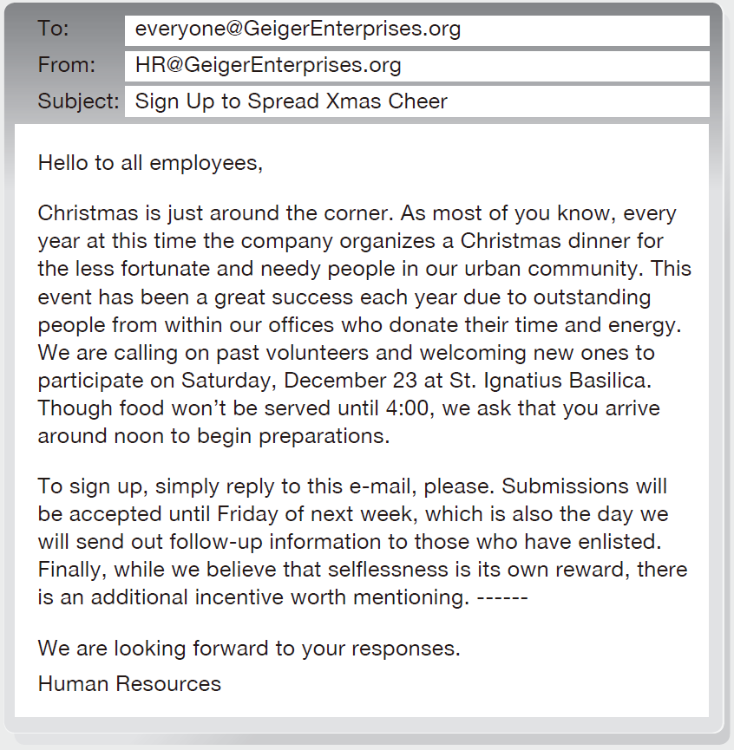
奠基篇 Unit 6
Exercise
Select the best answer to complete the text.
D
Q: ______
(A) Please take that with a grain of salt as we cannot make any guarantees.
(B) Those who do not sign up for the event will notice a deduction in their salary next month.
(C) In your e-mail, please note if you have any special skills that can be put to use.
(D) Participating employees will be entitled to a bonus vacation day to take at any time in the next year.

Slide 37
奠基篇 Unit 6
中文翻譯
收件者：everyone@GeigerEnterprises.org
寄件者：HR@GeigerEnterprises.org
主旨：報名登記散播聖誕節的歡樂氣氛
各位員工們好：
聖誕節就快到了。如同大部分的各位所知道的，每年的這個時候，公司會為了我們這個都會區裡的低收入戶及有需要的人們安排一頓聖誕晚餐。這個活動每年都因我們辦公室裡付出時間和精力的傑出同仁而獲得很大的成功。我們要號召之前的自願者，也歡迎新加入的夥伴於十二月二十三日星期六前來聖伊格納修斯教堂參與活動。雖然下午四點之後才會開始供應食物，但我們要求您在中午左右就抵達並開始準備。
欲報名者只須回覆這封郵件即可，謝謝。我們接受提交申請至下星期五，同時會在那天寄出後續資訊給報名參加的人。最後，雖然我們相信無私付出就是回報，但有個額外的獎勵值得提起。參加的員工會獲得一天的額外休假日，可在明年的任何時候使用。
我們期待您的回覆。
人力資源部

Slide 38
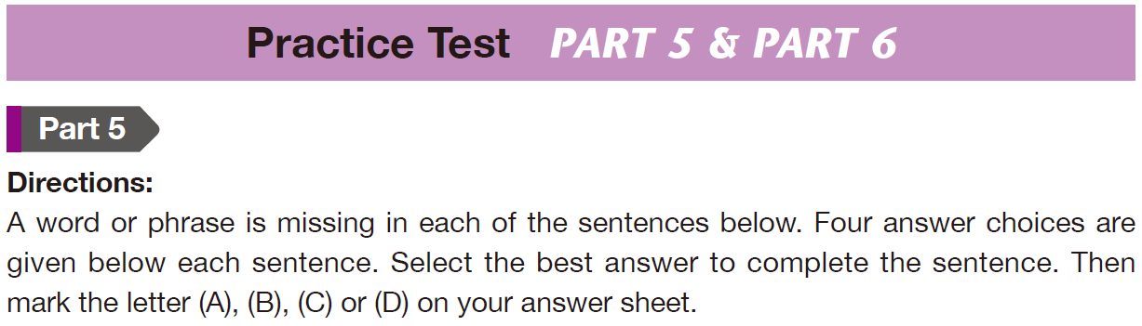
奠基篇 Unit 6

Slide 39
奠基篇 Unit 6
C
C
______ 1. It is difficult to be successful in business without some kind of ------- advantage.
(A) competing
(B) competition
(C) competitive
(D) competitively
沒有具備某些競爭優勢的話，很難在商場上成功。
______ 2. John said he couldn’t make the retreat because he had
------- made plans for the weekend.
(A) never
(B) since
(C) already
(D) anyway
約翰說他不能參加退休會，因為他這個週末已經安排好計畫了。

Slide 40
奠基篇 Unit 6
B
A
______ 3. You will be provided ------- an extensive handbook at the start of the seminar.
(A) for
(B) with
(C) against
(D) to
研討會開始的時候，你會被給予一本內容廣泛的手冊。
______ 4. Employees were allowed to invite three ------- to the company picnic, such as their spouse or other family members.
(A) guests
(B) clients
(C) visitors
(D) customers
員工們可以邀請三位客人來參加公司野餐，像是他們的配偶或其他家庭成員。

Slide 41
奠基篇 Unit 6
A
D
______ 5. It is impossible to maintain a ------- relationship with someone without trust.
(A) working
(B) wanting
(C) waning
(D) willing
沒有信任的話，是不可能和人維持一段良好關係的。
______ 6. There will be a $10,000 bonus to the staff member with the
------- sales this month.
(A) furthest
(B) farthest
(C) tallest
(D) highest
本月銷售額最高的員工，會有一萬元的獎金。

Slide 42
奠基篇 Unit 6
B
B
______ 7. We need to ------- the entire company of the new training policy.
(A) disseminate
(B) inform
(C) speak
(D) address
我們需要通知全公司新的培訓政策。
______ 8. Our manager ------- to the plan because it was going to be too expensive for the company.
(A) subjected
(B) objected
(C) injected
(D) projected
我們的經理反對這項計畫，因為對公司來說太昂貴。

Slide 43
奠基篇 Unit 6
A
C
______ 9. Someone is going to have to ------- the blame for losing that file.
(A) take
(B) make
(C) have
(D) find
有人要為檔案遺失負起責任。
______ 10. A decrease in the number of nursing home residents has been ------- to seniors over the age of 65 being healthier and wealthier.
(A) included
(B) studied
(C) attributed
(D) marked
住在安養中心之中的人數下降，是因為六十五歲以上的長者更健康、更富有。

Slide 44
奠基篇 Unit 6
C
C
______ 11. The main guest on the show tonight is John Wilkes, ------- has a new movie out.
(A) where
(B) which
(C) who
(D) that
今晚節目的特別來賓是約翰‧徫克斯，他有新電影問世。
______ 12. The hotel lobby’s gift shop sold handmade crafts, but Deborah didn’t buy any because they ------- too much.
(A) spent
(B) pay
(C) cost
(D) worth
飯店大廳的藝品店有賣手工藝品，不過黛柏拉沒有買，因為那些東西要價不斐。

Slide 45
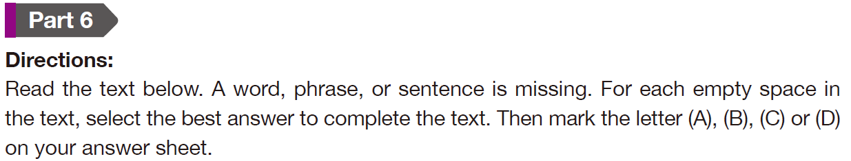
奠基篇 Unit 6

Slide 46
奠基篇 Unit 6
Questions 13-16 refer to the following help wanted ad.
Wanted: Assistant Store Manager Kelly’s Clothing is looking for an assistant store manager to work evenings and some weekends. The ideal candidate will have at least three years of experience ___13___ a retail store. Excellent communication skills are essential, ___14___ is the ability to motivate staff to provide the best in customer service. Fluent English skills are necessary for the job. Proficiency in Spanish is preferred.
C
13. (A) manage
(B) to manage
(C) managing
(D) managed
14. (A) since
(B) both
(C) as
(D) either
C

Slide 47
奠基篇 Unit 6
Kelly’s is one of the region’s fastest-___15___ clothing stores, providing brand-name attire for men and women at bargain prices. Offering attractive salaries and excellent benefits, we were voted one of the Best Places to Work in 2010 by Work in 2015 by Retail Magazine. ___16___
B
15. (A) grow
(B) growing
(C) growth
(D) grown
16. (A) Thank to all employees past and present who have made Kelly’s Clothing what it is today.
(B) Please keep us in mind again this year when casting your vote.
(C) Check the enclosed brochure for the list of prices.
(D) To apply, please send a cover letter and résumé to Margaret Campbell at mcampbell@kellyclothing.com.
D

Slide 48
奠基篇 Unit 6
中文翻譯
誠徵：助理店長
「凱莉服飾」徵求一名助理店長，上班時間為晚上及部分週末。理想人選須具備至少三年的零售店鋪管理經驗。必須具備絕佳的溝通技巧，且能鼓舞員工提供最佳客戶服務。本工作需要流利的英語能力。通曉西班牙語尤佳。
「凱莉服飾」是本區成長最快的服飾店之一，提供低價男女名牌服裝。我們的薪資優渥，福利絕佳，而且曾被《零售雜誌》評選為二〇一五年最佳工作場所。應徵者請將求職信及履歷寄給瑪格麗特‧坎貝爾，電子郵件信箱：mcampbell@kellyclothing.com。
• essential (adj.) 必要的；不可缺的
• proficiency (n.) 精通；熟練
• attire (n.) 服裝；衣著

Slide 49
奠基篇 Unit 6
Part 5 句子填空
&
Part 6 短文填空
-The End-

